Slide 1

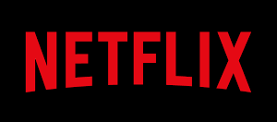
Project 1 group 3
by
Dan Freda
BANU Nathan
AHMED MOHAMED

Slide 2
About: Netflix
- Neil Armstrong Netflix, Inc. is an American over-the-top content platform streaming service and production company headquartered in Los Gatos, California. Netflix was founded in 1997 by Reed Hastings and Marc Randolph in Scotts Valley, California

Slide 3
Netflix in the Age of the Streaming Wars
PRIMARY Question: Has the composition of Netflix content evolved in recent years in response to heightened competition and diminished licensing opportunities?
Hypothesis: There will be an observable trend towards tv show distribution relative to that of movies as a result of increased distribution of original content (primarily manifesting as Tv series), in addition to a comparative advantage in quantity of quality content to that of its peer competitors.

Slide 4
Objectives
Objectives:
Conduct exploratory data analysis utilizing datasets comprising the Netflix content library, in addition to its primary competitors with attention to features such as:
Content type
Genre
National origin
Release date (Films)
Date added
Age guidance ratings
IMDb and Rotten Tomatoes Ratings (quality of content indicators)
Netflix Original productions
Visualize summary data analysis.
Identify observed trends and changes in the composition of Netflix content over time.
Posit potential explanations for observed data results.
Conduct comparative analysis of Netflix content with that of its primary market competitors:
Amazon Prime Video
Hulu
Disney+

Slide 5





Datasets
Netflix Data: netflix_titles.csv retrieved from https://www.kaggle.com/shivamb/netflix-shows
Netflix Data: MoviesOnStreamingPlatforms_updated.csv retrieved from https://www.kaggle.com/shivamb/netflix-shows
Netflix Data: tv_shows.csv retrieved from https://www.kaggle.com/shivamb/netflix-shows

Slide 6
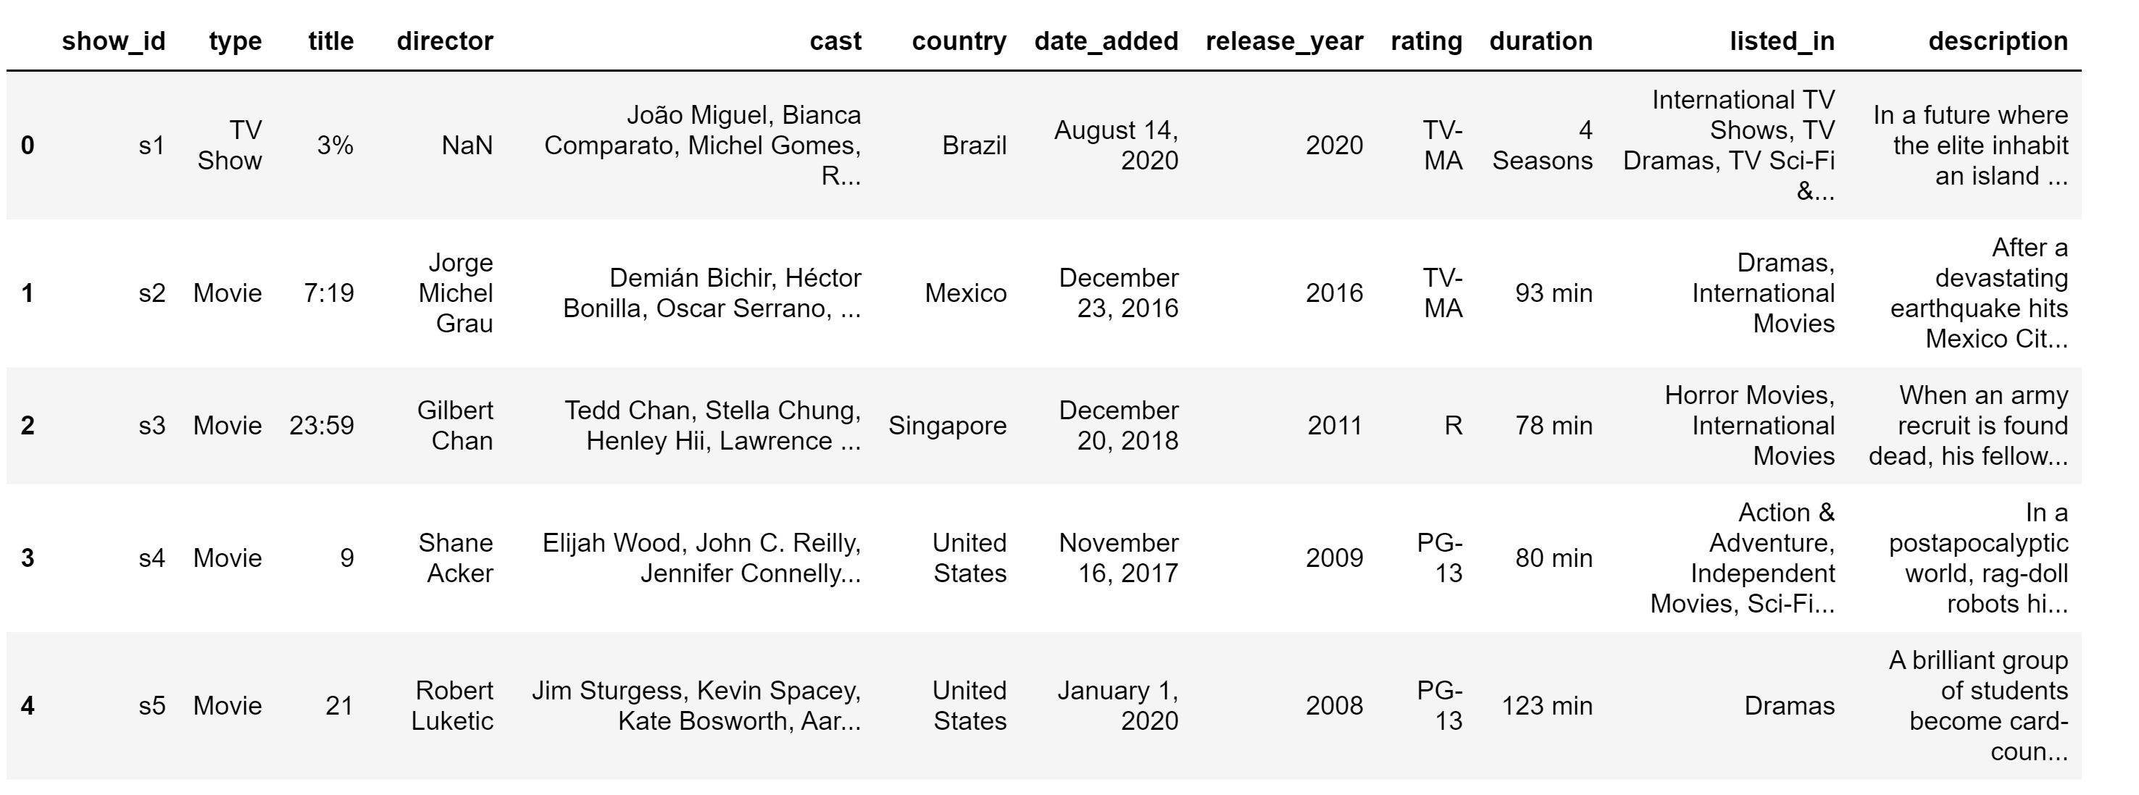
Netflix Data: netflix_titles.csv retrieved from https://www.kaggle.com/shivamb/netflix-shows

Slide 7
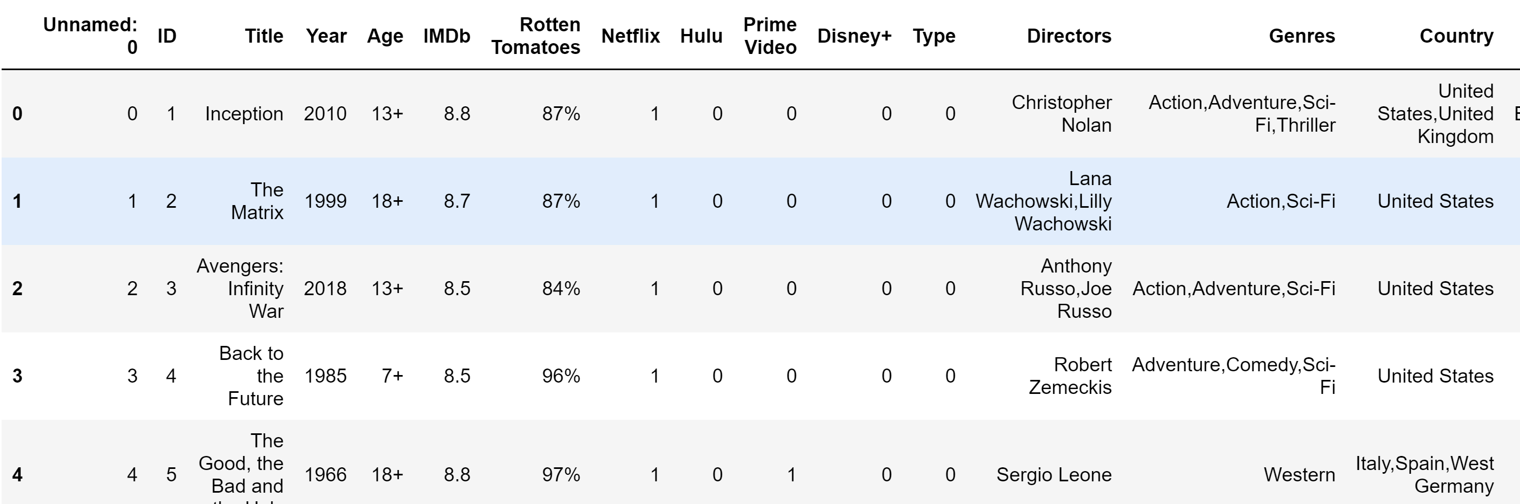
Netflix Data: MoviesOnStreamingPlatforms_updated.csv retrieved from https://www.kaggle.com/shivamb/netflix-shows

Slide 8
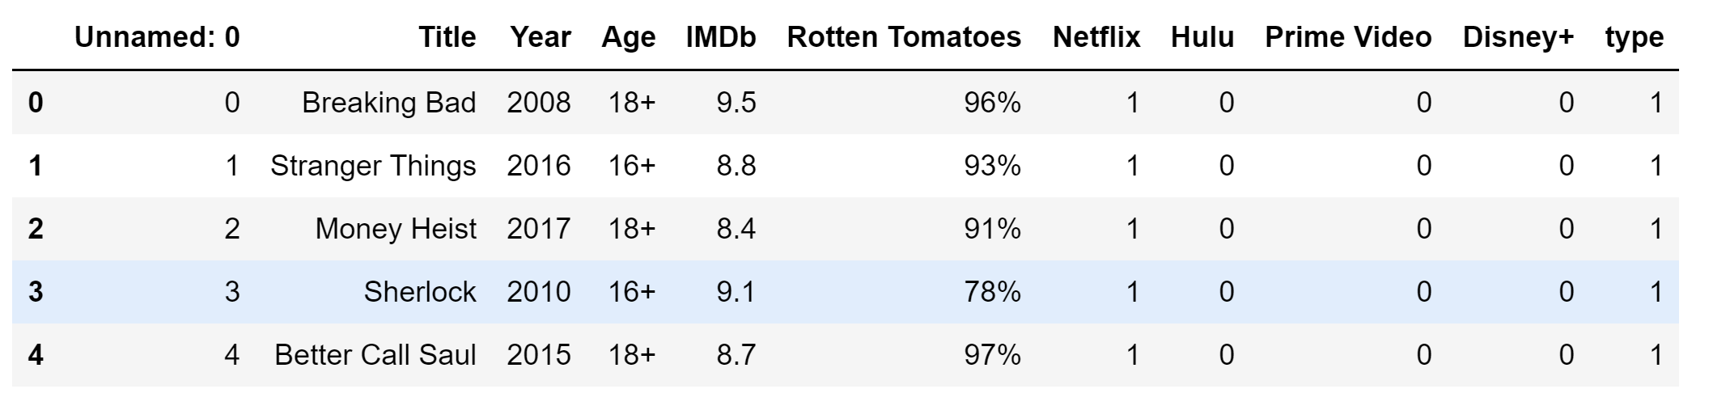
Netflix Data: tv_shows.csv retrieved from https://www.kaggle.com/shivamb/netflix-shows

Slide 9
Describe TV AND MOVIES BY IMDB
Tv Shows
MOVIES
count mean | 4450.000000
mean | 7.113258
std | 1.132060
min | 1.000000
25% | 6.600000
75% | 7.300000
max | 9.600000
count mean | 16173.000000
mean | 5.902751
std | 1.347867
min | 0.000000
25% | 5.100000
75% | 6.100000
max | 9.300000

Slide 10
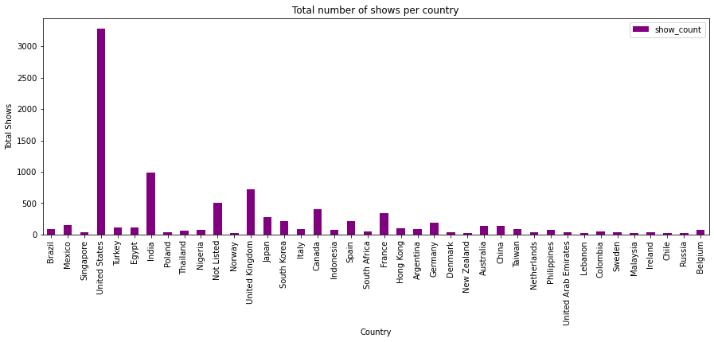
Total Number of Titles by Principal Country
The United States is the principal country of origin for the vast majority of titles distributed on Netflix globally.

Slide 11
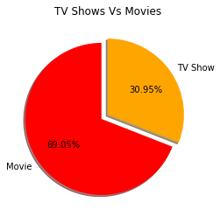
Netflix Content Type by Proportionality
As demonstrated in this visualization, Netflix’s content library is composed primarily of movies at more than a 2:1 rate to that of tv shows.
However, trends observed in recent years suggest the proportionality observed here is likely to narrow over time.

Slide 12
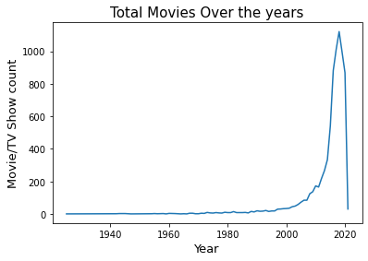
Netflix Content Distribution by Production Release Date
As evidenced here, the distribution of Netflix content according to release date is heavily skewed left.
The substantial majority of content was released in recent years with a sharp decline in 2020 (production limited due to COVID-19 pandemic).

Slide 13
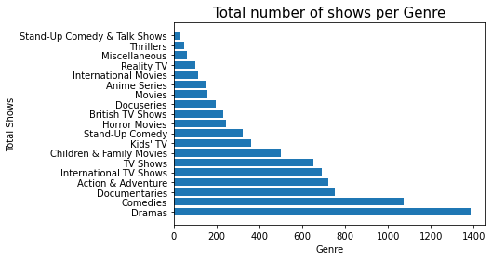
Netflix Content Distribution By Genre
The top five genre by total distribution rank as:
Dramas
Comedies
Documentaries
Action & Adventure
International TV Shows
* The general distribution of overall content by genre is fairly consistent amongst Netflix, Hulu, and Prime Video are fairly consistent with the outlier being Disney+ whose content is heavily weighted towards children and family based content.

Slide 14
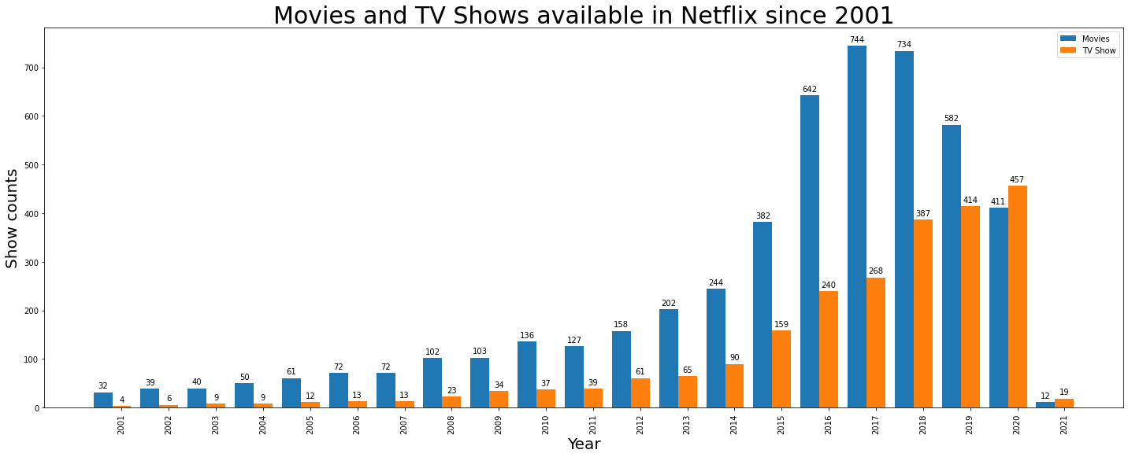
Has this distribution changed over recent years (i.e. is Netflix focusing increasingly on tv shows relative to movies in recent years)?
Netflix Movies and TV Available Each Year Since 2001 (Visualized in Raw Numbers)

Slide 15
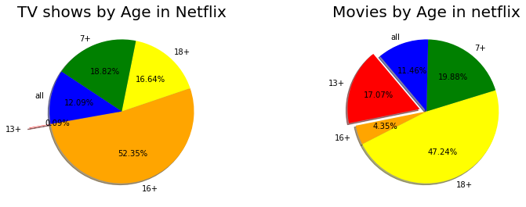
Netflix Content Distribution According to Age Guidance Ratings

Slide 16
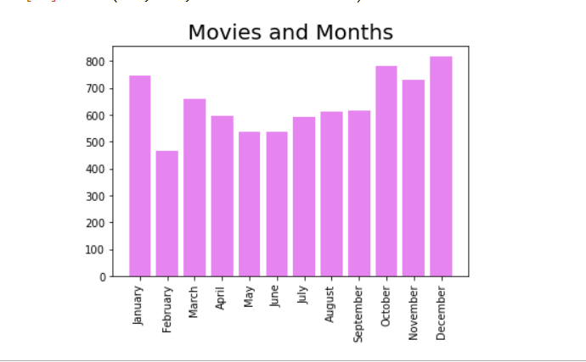
MOVIES AND MONTHS

Slide 17
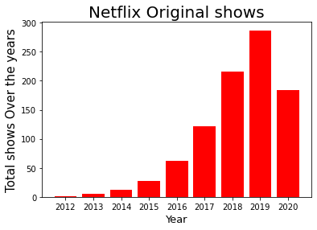
Distribution of Netflix Original Productions By Year
Netflix’s output of its Netflix Originals Series productions has grown significantly in recent years, but slowed in 2020 due to COVID-19 pandemic.
The marked increase observe here is likely in response to increased market competition.
With fewer quality titles available to license, Netflix has focused more resources into producing original content, as exclusive content has grown in importance.

Slide 18
A Comparison of Content Libraries Amongst the Major Streaming Services
 | Netflix | Prime Video | Hulu | Disney+
TV Shows | 1,931 | 2,144 | 1,754 | 180
Movies | 3,560 | 12,354 | 903 | 564
Total Content | 5,491 | 14,498 | 2,657 | 744
Observations:
Amazon Prime Video has a substantially larger content library than its competitors with 14,498 titles of total content.
Disney+, while only having 744 titles in its content library, these titles are exclusively Disney owned intellectual properties.
Unlike the other streaming services, a substantial majority of Hulu’s content library is comprised of tv shows.

Slide 19
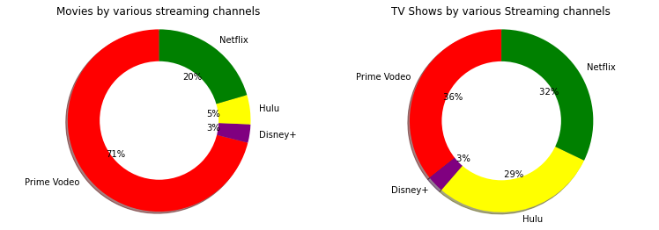
Proportionality of Overall Aggregate Data Amongst Primary Streaming Services Separated by Content Type

Slide 20
Quality vs. Quantity Amongst the Major Streaming Services
For this analysis, we utilize IMDb Ratings and Rotten Tomatoes Scores as indicators of quality in order to categorize what can be considered quality content.
Then we measure the amount of titles that satisfy certain thresholds (IMDb: 7.5, Rotten Tomatoes: 60%).
Subsequently, we are able to calculate the percentage of titles in overall content that can be consider of high quality for each respective platform.

Slide 21
IMDb Rating and Rotten Tomatoes Score Defined
IMDb Rating
Rotten Tomatoes Score
The IMDb rating we are utilizing is based on an aggregation of audience reviews.
The threshold we are utilizing only counts titles with a minimum rating of 7.5.
While this 7.5 rating is somewhat arbitrary, titles satisfying this threshold are widely considered of good quality and it is more inclusive of a variety of film genres than a more restrictive rating of 8 or 9.
Rotten Tomatoes Score aggregates film reviews, but is exclusively focused on critic reviews.
Films that cross a certain threshold of positive reviews are considered ‘certified fresh’.
The ‘certified fresh’ threshold is 60%.

Slide 22
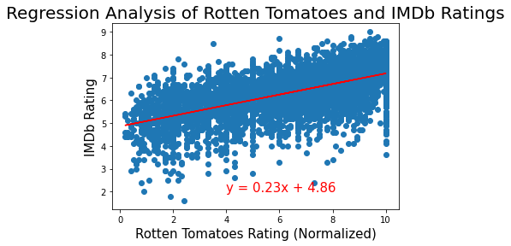
A Positive Correlation between IMDb Rating and Rotten Tomatoes Score

Slide 23
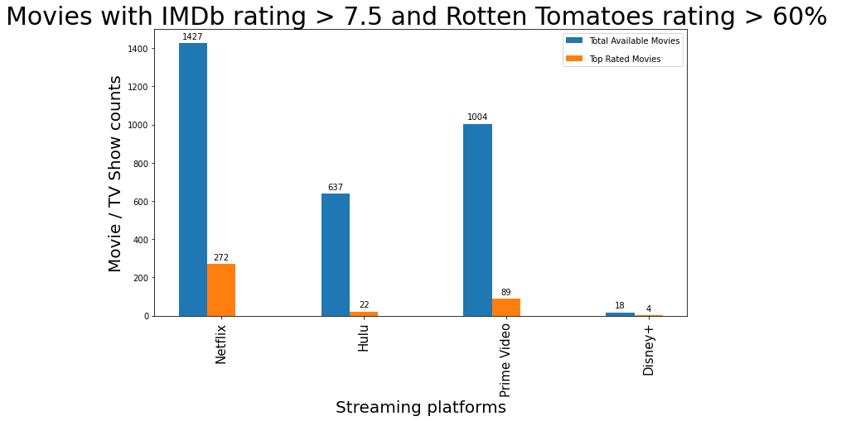
High Quality Movies on Streaming Services

Slide 24
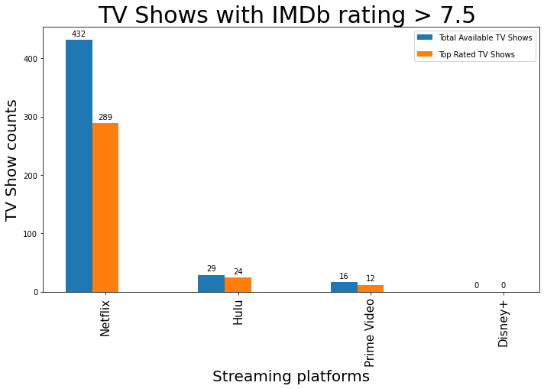
High Quality TV Shows on Streaming Services

